Slide 1
Windows Registry Forensics

Slide 2
A central hierarchical database used in Microsoft Windows 98, Windows CE, Windows NT, and Windows 2000 used to store information that is necessary to configure the system for one or more users, applications and hardware devices
The Registry contains information that Windows continually references during operation, such as profiles for each user, the applications installed on the computer and the types of documents that each can create, what hardware exists on the system, and the ports that are being used. The registry contains two basic elements, keys and values
Registry keys are container objects similar to folders while values are non-container objects similar to files. Keys may contain values or further sub keys.

Slide 3
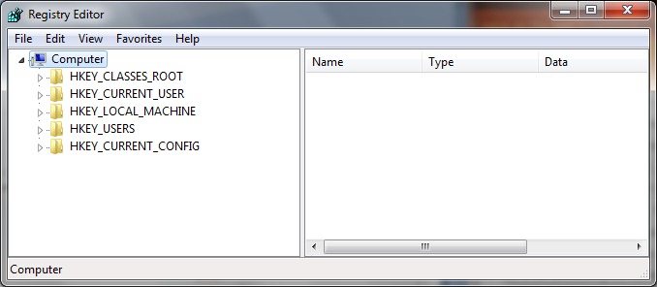
Hives

Slide 4
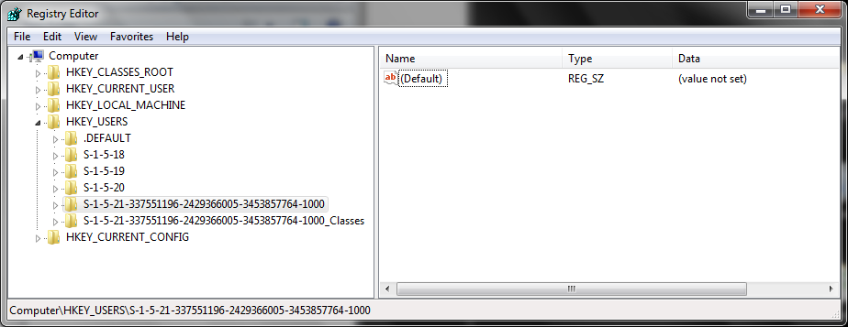
Value
Key

Slide 5
Hive Properties
HKEY_USERS: All loaded user data
HKEY_CURRENT_USER: Currently logged on user data
HKEY_LOCAL_MACHINE: Contains array of software and hardware settings
HKEY_CURRENT_CONFIG: Hardware and software settings at start-up
HKEY_CLASSES_ROOT: Contains information an application needs to use in order to open files

Slide 6
Information in Registry
System Configuration
Devices on the System
User Names
Personal Settings and Browser Preferences
Web Browsing Activity
Files Opened
Programs Executed
Passwords

Slide 7
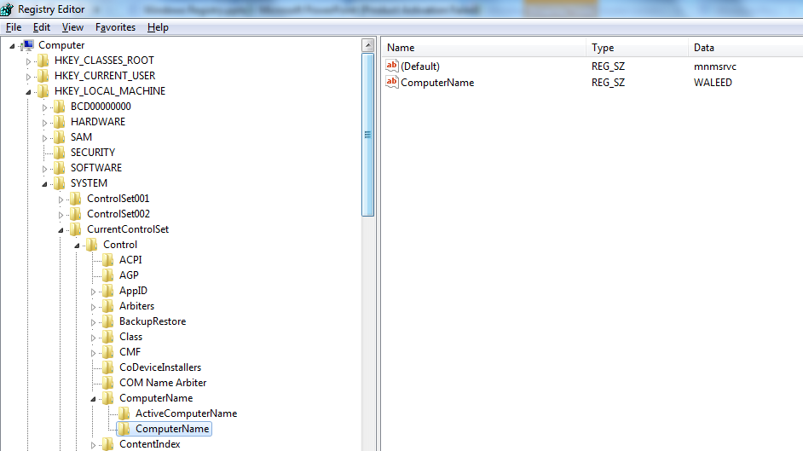
Computer Name
HKEY_LOCAL_MACHINE\SYSTEM\CurrentControlSet\Control\ ComputerName

Slide 8
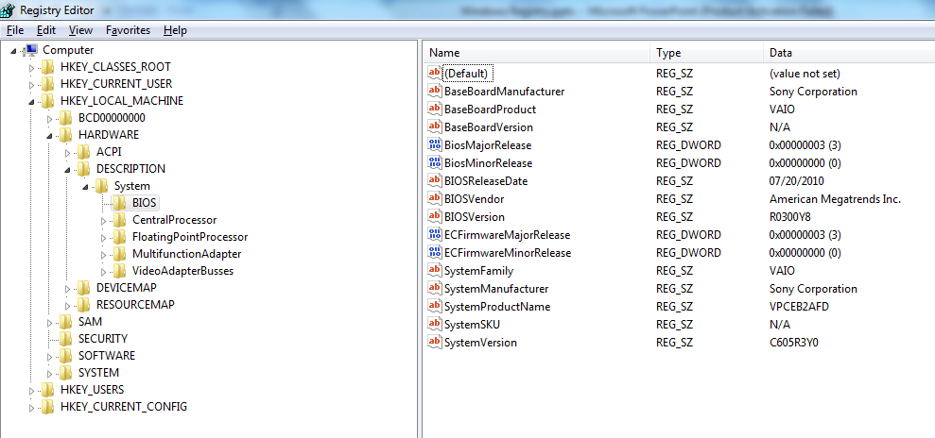
Hardware Information
HKEY_LOCAL_MACHINE\HARDWARE\DESCRIPTION\System\BIOS

Slide 9
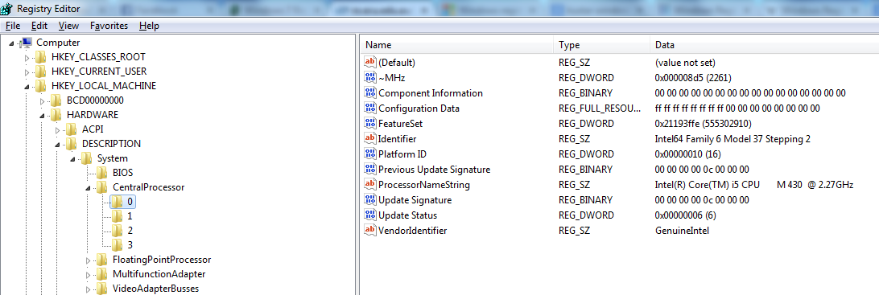
Processor Information
HKEY_LOCAL_MACHINE\HARDWARE\DESCRIPTION\System\ CentralProcessor\0

Slide 10
User Information
There are a number of elements of information about the user account that are stored in the Registry. For example a list of user accounts, last login time of each account, whether it requires a password, whether it is a disabled or enabled account and the method used to hash the password of the user account. All of this information is held in the following Registry key:
HKEY_LOCAL_MACHINE \SAM\Domains\Account\Users

Slide 11
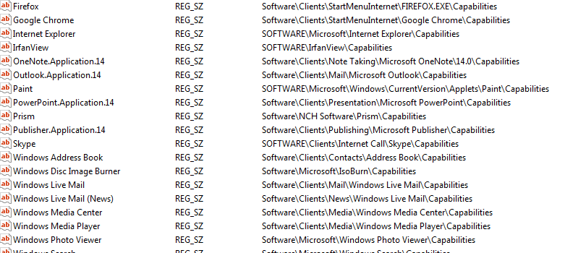
Registered Applications
HKEY_LOCAL_MACHINE\SOFTWARE\RegisteredApplications

Slide 12
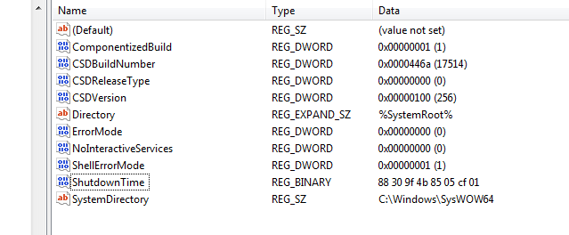
Last Shutdown
HKEY_LOCAL_MACHINE\SYSTEM\ControlSet001\Control\ Windows
Use any Decoder to get the actual date and time, e.g. Dcode.

Slide 13
Startup Programmes
HKEY_LOCAL_MACHINE\SOFTWARE\Microsoft\Windows\ CurrentVersion\Run

Slide 14
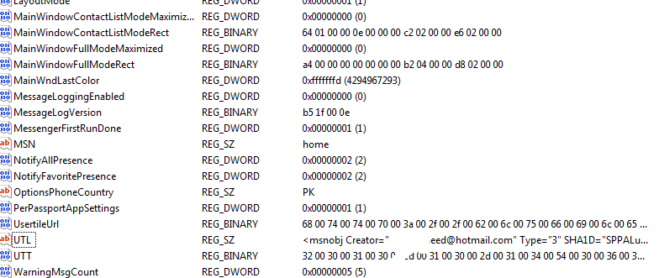
MSN Info

Slide 15
Skype Information
HKEY_USERS\S-1-5-21-[User Identifier]\Software\Skype\PluginManager

Slide 16
Network Analysis
Network Cards
The Registry holds a list of all network cards whether the network card is built in or is an external network card. In most laptops there are two type of network card: the Ethernet network card and Wi-Fi network card. The following Registry key holds a list of network card:
HKEY_LOCAL_MACHINE\SOFTWARE\Microsoft\Windows NT\CurrentVersion\NetworkCards

Slide 17
Wireless Networks
Windows Registry holds important information for the forensic investigator about Wireless networks. This information includes the created date and last connected date. They are stored in the following Registry sub key:
HKEY_LOCAL_MACHINE\SOFTWARE\Microsoft\Windows NT\CurrentVersion\NetworkList\Profiles\{Wireless - Identifier}

Slide 18
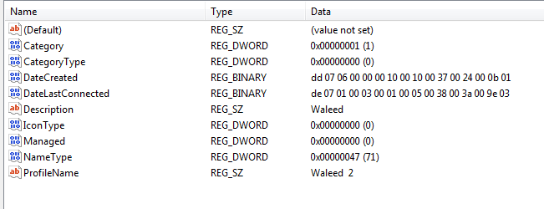

Slide 19
Attached Device Analysis
Printers
There are a number of keys within the Registry that hold information about printer drivers that exist in the system. One of these keys is the following:
HKEY_LOCAL_MACHINE\SYSTEM\ControlSet001\Control\Print\Printers
USB Devices
Any time a new USB Device is connected to the system, it will leave information about this USB device within the Registry. This information can uniquely identify each USB device connected to the system. The Windows Operating system stores vendor ID, product ID, Revision and Serial No. for each connected USB device. This information can be found in the following Registry key:
HKEY_LOCAL_MACHINE\SYSTEM\ControlSet001\Enum\USBSTOR

Slide 20
History List
The history lists highlights the most recent activity on the system. For example recently visited web pages or recently opened word files. There are several sub keys in the Registry that show recent activity by the system users

Slide 21
HISTORY LIST | RELATED WINDOWS REGISTRY KEY
Typed URLs in Microsoft Internet Explorer | HKEY_USERS\S-1-5-21-[User Identifier] \Software\Microsoft\Internet Explorer\TypedURLs
Most recently used Microsoft Word files | HKEY_USERS\S-1-5-21-[User Identifier] \Software \Microsoft\Office \12.0\Word\File MRU
Most recently used Microsoft Power Point files | HKEY_USERS\S-1-5-21-[User Identifier] \Software\Microsoft \Office \12.0\PowerPoint\File MRU
Most recently used Microsoft Excel files | HKEY_USERS\S-1-5-21-[User Identifier] \Software \Microsoft \Office \12.0\Excel\File MRU
Recent Acrobat Reader Files | HKEY_USERS\S-1-5-21-[User Identifier]\Software\Adobe\Acrobat Reader\9.0\AVGeneral\cRecentFiles
Recent WinRAR files | HKEY_USERS\S-1-5-21-[User Identifier] \Software \WinRAR \ArcHistory

Slide 22
HISTORY LIST | RELATED WINDOWS REGISTRY KEY
Most recently used wallpapers in the desktop | HKEY_USERS\S-1-5-21-[User Identifer] \Software \Microsoft \Windows\CurrentVersion\Explorer\Wallpaper\MRU
Most recently typed command on the RUN Dialog | HKEY_USERS\S-1-5-21-[User Identifier] \Software \Microsoft \Windows\CurrentVersion\Explorer\RunMRU
Recent .GIF files | HKEY_USERS\S-1-5-21-[User Identifier] \Software \Microsoft \Windows\CurrentVersion\Explorer\RecentDocs\.gif
Recent .jpg files | HKEY_USERS\S-1-5-21-[User Identifier] \Software \Microsoft\Windows\CurrentVersion\Explorer\RecentDocs\.jpg
Recent text files | HKEY_USERS\S-1-5-21-[User Identifier] \Software \Microsoft\Windows\CurrentVersion\Explorer\RecentDocs\.txt
Recent folders | HKEY_USERS\S-1-5-21-[User Identifier] \Software \Microsoft\Windows\CurrentVersion\Explorer\RecentDocs\Folder
Recent Zip files | HKEY_USERS\S-1-5-21-[User Identifier] \Software \Microsoft \Windows\CurrentVersion\Explorer\RecentDocs\.zip

